Slide 1
Dedicated to Successful Business Re-Engineering and Business Optimization Practice Overview
2017

Slide 2
Consulting overview
PFE provides full life cycle business change management in support of strategic initiatives, restructuring, cost take-out, funding, mergers, acquisitions, business emergencies and systems re-platforming.
PFE also offers consulting services supporting the systems & technology, order fulfillment, shipping, distribution, warehousing, customer service and supply chain management functions frequently associated with consumer focused businesses.
PFE can provide any or all of the services required to affect successful business change, repair and rescue, from initial situational evaluation, change planning, cost estimation and risk evaluation all the way through project management and results reporting.
PFE can manage the execution of plans and projects developed by us or others. We offer full life cycle change program management.
PFE provides "due diligence" services for funding, investment and mergers and acquisition activity.
PFE was founded in 2007 by a former C-level executive in specialty retail with groundbreaking experience introducing on-line commerce and direct-to-consumer fulfillment into a traditional Fortune 1000 multi-brand bricks-and-mortar retailer.
PFE continues to operate a legacy practice supporting government entities, especially public safety agencies, in optimizing operations, reporting, record keeping and the related technology.

Slide 3
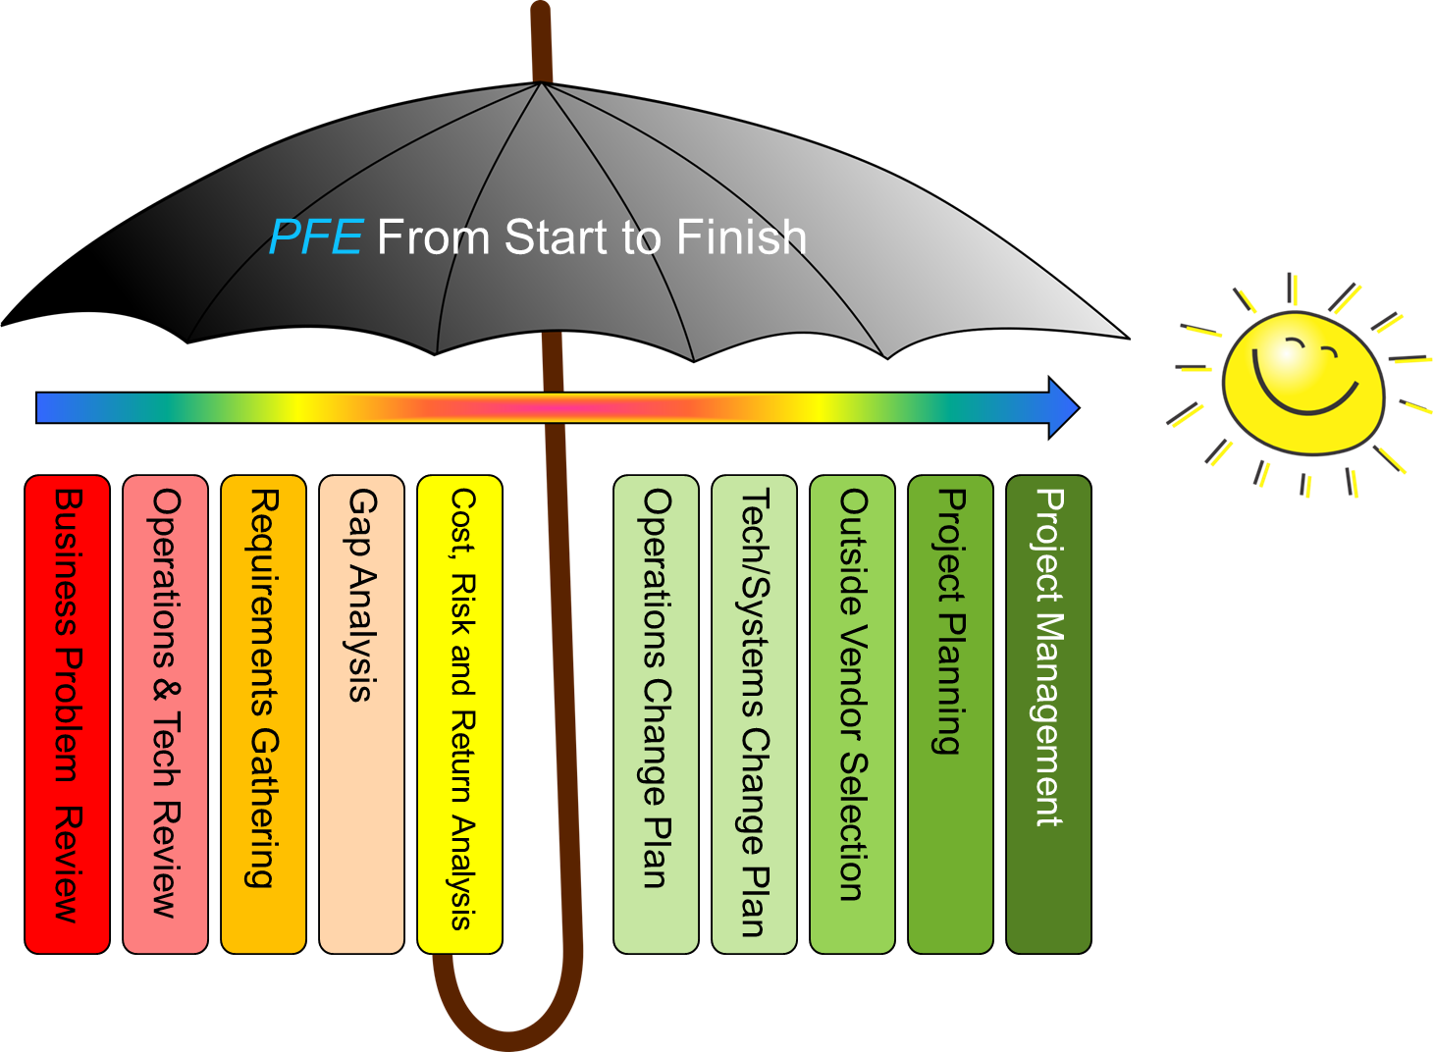

Slide 4
Typical client engagements
Consolidation of 2 company merger with redundant operating divisions
Direct-to-consumer fulfillment center move and re-platform
Direct to consumer operations cost take out and optimization
Operational review and recommendation for a 3 division consolidation
E-Commerce re-platform
In-source of legacy 3PL fulfillment operation
Start-up E-commerce operation optimization
ERP re-platform
Emergency in-source of failed outsourced e-commerce operation
Fulfillment warehouse operational design and construction
Legacy ERP to E-commerce integration
Order management system selection and implementation
Warehouse management system selection and implementation
Merger due diligence
E-Commerce technology provider sales and business positioning advisor

Slide 5
Where have we helped?
“We want to add an on-line channel, but don’t know how to proceed...”
“Our business structure was once ideal, but in today’s volatile environment, we are no longer competitive. How do we change our structure...”
“Our legacy core business systems are obsolete and we need to re-platform, but we don’t know where to start...”
“Our technology leaders are only familiar with legacy systems and software. Our options there are limited. How do we move on to state-of-the-art systems and technology...”
“Our D2C fulfillment warehouse operation was built by the seat of our pants and is not as efficient as I think it could be, can you help…”
“My business people and systems people and are not coordinated and consequently, we can’t serve customers the way we want to …I’m also worried about payback and risk...”
“We need to insource our current 3PL based fulfillment operation to optimize cost, but we have no experience operating this function in-house. How do we pull this off...”
“I have a growing multi-channel business but I don’t understand what investment will be needed going forward or what organization structure I should have...”
“We have a great idea for expanding our business, but we’re just not getting it off the ground fast enough and we are missing growth opportunities – no one has time to focus...we need help getting things started...”
“My internal team is willing to take on this major project, but I need to manage the risk and insure success. How do I manage this and keep an eye on things...”

Slide 6
PFE is a virtual company
We employ a pre-qualified group of sub-contractors and strategic partners that work for us on a project basis, insuring that we can provide an exact match to the skill sets required on each client engagement.
We can staff project teams of almost any size.
Many of our associates have C-suite credentials in appropriate subject matter areas.
Typical project team size is 2-5 PFE associates.
We work on 2-3 engagements at any one time and all engagements are manager by the principal directly.

Slide 7
Working with PFE…
We are honest and direct
We are what we claim to be. Our experience is accurate and reference-able. We live and die by our reputation.
We operate and deliver against a contractually agreed upon project plan, even on small, short term engagements
We engage quickly, first results in 7-10 days in most cases
Our engagements are structured to deliver tangible results quickly with a fixed schedule of expected deliverables on a very frequent basis
We are ALWAYS willing to execute what we recommend
Our solutions are never “blue sky”
We combine hard analytics, practical operating experience and creative entrepreneurial insight with a strong understanding of our clients and their customers to make sure that the solutions we propose are realistically achievable.
We will act as project managers for plans we recommend, including in acting executive lead roles
We integrate
We are 100% “hands-on”
We are comfortable engaging at all levels of a business, working with sr. management and salaried workers with the same level of comfort and with appropriate “sensitivity”
We build relationships with our clients and their associates
We “speak the language”
We can converse with and present comfortably and appropriately “in the board room or the break room”. We are comfortable presenting at the highest organizational levels, or to the “rank and file” as necessary.
We mentor
Our implementations and managed projects involve “handholding” as necessary and at any level. We will mentor and support the individual warehouse worker just as seriously as we mentor and support the CEO
We communicate
Daily, weekly, monthly status reporting and face-to-face communication with all critical client representatives with full transparency. The bad with the good in all circumstances.
We only take on work that our consultant have the expertise to perform
We do not “learn on the job”…we apply experience. PFE leverages the experiential and operating strengths of our associates… they know the industry, they shape and manage the engagement plan and they execute the work…
Our approach is predicated on:
An insatiable drive for simplicity
A heavy reliance on common sense, and …
Unparalleled attention to detail

Slide 8
…Working with PFE
We are cost effective
Not “cheap”, but efficient
We use our experience, relationships and large database of previous engagements to operate efficiently, with little waste motion, providing fast results and on-time deliverables while expending minimal billable hours.
For well defined projects, we offer fixed pricing as an alternative to time and materials pricing
Follow up is free- we do not bill for after-the-fact questions and simple informational requests.
References at the C-suite level
P&L focus
Even our small engagements have a business centric profit and loss focus.
TCO (Total Cost of Ownership) and ROI (Return on Investment) analysis are almost always a deliverable of a PFE engagement
Risk determination and worst case cost are always in focus
Client staffing impact, re-training, attrition and both positive and negative HR impacts are key deliverables
We are invested in our clients success… not just their stated requirements
A former client once commented: “You provided us with what we needed… disguised as what we asked for”

Slide 9
Action is the objective…
We place great emphasis on making recommendations that are “actionable” and tailored to each client. We work with you at every level to ensure success.
PFE has considerable executive operating experience, we are not just consultants, we understand how to manage a profitable enterprise
Strategy | It is not enough to have a solid Strategic Approach . . . It must be appropriate to the resources of the client.
Tactics | It is not enough to have an excellent Tactical Plan . . . it must be executable.
Execution | Execution must be flawless . . . and continuously measured for results.

Slide 10
Example: Re-platforming engagement managed time & action
Scoping
Client Requirements
RFP Development
RFP Distribution
Proposal
Collection
Vendor Pool Selection
Proposal
Scoring
Vendor Shortlist
Vendor On-Site Presentations
Cost Analysis w/ TCO
On-Site Agenda
Vendor Relations/Vendor Communications
Vendor Selection
Contract Negotiations
Program Management
SOW/MSA
Negotiations
Cost Tracking/Management
Project Management & Reporting
Staffing
Training
Master Plan
Development
Operating Process Re-design
Documentation
Vendor Relations/Vendor Communications

Slide 11
Joe Hardiman
Mr. Hardiman is the founder and the sole principal of PFE Systems, Inc. PFE was founded in 2007.
Mr. Hardiman is a business management, business process and technology consultant with more than 25 years of ground breaking experience in a broad range of industries including e-commerce, catalog, retail, shipping, insurance and financial. He has focused extensively for the past 15 years in helping companies with the e-commerce enabling of their legacy businesses and repairing and restructuring businesses in the middle tier. Mr. Hardiman has worked on e-commerce business strategy and operations enablement, selection and implementation of technology platforms (web presence, on-line marketing, order management, ERP, warehouse management, payment systems, analytics and social media, mobile, etc.) and overall optimization of direct-to-consumer and retail supply chain logistics.
Mr. Hardiman is an experienced C-suite executive with success in the building and restructuring of businesses using technology as an instrument of change and evolution. Mr. Hardiman has served in a variety of management roles and has had general management responsibilities for several start-ups including the E-commerce division of a traditional Fortune 1000 bricks-and-mortar retailer. Mr. Hardiman was a Vice President with Charming Shoppes® (parent company of Lane Bryant®, Fashion Bug®, Catherines®, Petite Sophisticate® and Figure® Magazine) and was founder and the general manager of CSI’s internet division for 7 years. Prior to this, he was an operations vice president for Alight.com, an internet pure-play in the woman’s apparel retail space.

Slide 12
Strategic partnerships
TGC offers a full range of consulting services to retail, ecommerce wholesale and omni-channel businesses, as well as investment firms focused on the consumer sector. Our team brings "best of breed” resources to bear on every functional area of the business.
PCF Consulting Group is a principal-controlled consultancy dedicated to helping retailers and business service providers achieve multi-channel and on-line excellence..

Slide 13
Notable recent clients

Slide 14
Example: Due diligence engagement
Organization Assessment
Organization structure and management
Capacity
Competencies, resource depth and skill set
Gap analysis
Review of Business Channels (E-Commerce for instance)
Strategy and financial performance review
Business plan validation
Gap analysis
Technology Assessment
Management and accountability
Platforms, architecture, longevity and capacity
Standards compliance
Auditability and risk assessment
Gap analysis
P&L Impact
Projected expense evaluation
Projected capital requirements
Overall forward looking

Slide 15
Contact us
Joe Hardiman, President and Principal
PFE Systems, Inc.
22 Aspen Road, Sloatsburg NY 10974
(845) 712-5281
jhardiman@pfesys.com
PFE is centrally located in Rockland County, New York, in the heart of the New York Metropolitan area, 38 miles from Central Park, 100 miles from Philadelphia, 65 miles from Stamford, CT.

